Slide 1
PACCAR Parts
Advanced Analytics

Slide 2

PACCAR Leadership Roles
Assistant Director Marketing Technology | Brett Durfee
PACCAR Hire Date | June 2007
Education
MBA – Seattle University (2014) BA – Business, Columbia College (1997)
PACCAR Experience (Emerging Leader Cohort 2009)
PACCAR Corporate | Sr. Project Director Battery Factory Sr. Internal Auditor |  | Apr 2024 – Dec 2024 Nov 2010 – Nov 2012
PACCAR India | Managing Director |  | Oct 2021 – Mar 2024
PACCAR Parts | Director IT Delivery |  | May 2017 – Sep 2021
PACCAR ITD | Director (Security, Infrastructure, Apps (3)) Sr. Project Manager |  | Dec 2012 – Apr 2017 Jun 2007 – Oct 2010

Slide 3
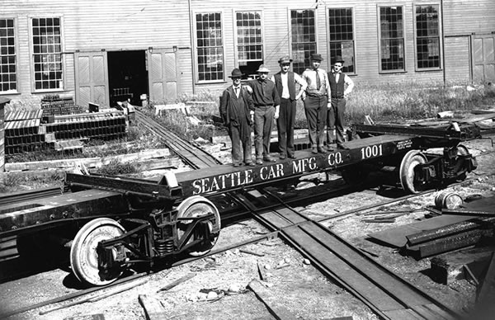
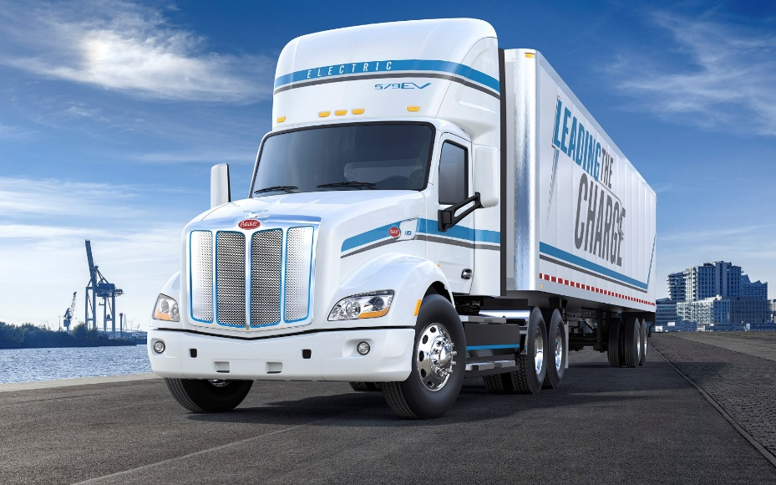
What is PACCAR?
History
Founded in 1905
1945 Entered Into Heavy Duty Trucking
1973 PACCAR Parts Established
1945
Today
Operate Three Major Brands Globally
2024 Revenue of $33.7 Billion
30K Employees
2024

Slide 4




Notes:
Brett

Slide 5
Data Scientists at PACCAR
Computer Science
Data Analysis & Mathematics
Business Knowledge
Data Wrangling
Focus on the “why”
Be Creative
Build relationships
Time & Complexity

Slide 6

What Makes a Successful Data Scientist
Creativity
Connecting Multiple Domains
Combining Algorithms
Communication
Explaining Complex Algorithms
Communicating Insights

Slide 7
Version Control
Repository Setup
Data Analysis
Data Model
main
Squash
data_analysis
Squash
Modeling_lr
Data_model_1.0
Modeling_rf

Slide 8
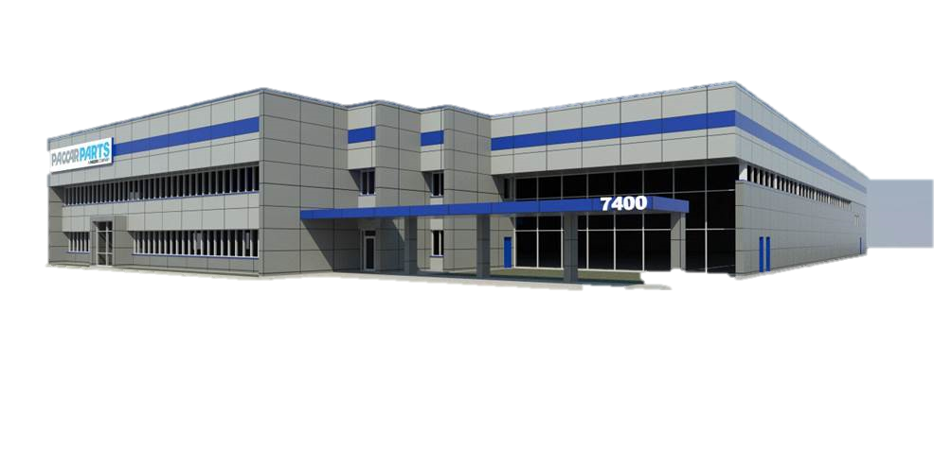


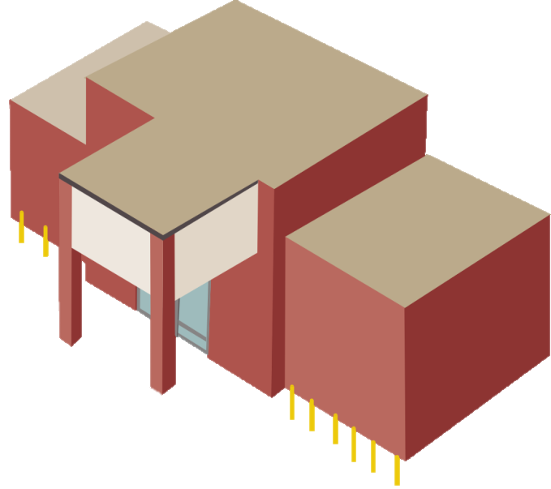





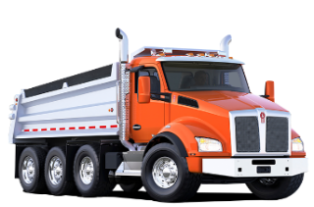

Commodity Supply Chain
78% On Time Shipping
95.5% Regional Fill
98.5% National Fill

Slide 9






Ordering Process
Quantities are created and suggested to inventory planners
Suggestions are manually reviewed and ordered by an inventory planner
Parts are ordered and then delivered to a PACCAR warehouse

Slide 10
Is Our Plan Followed?

Slide 11
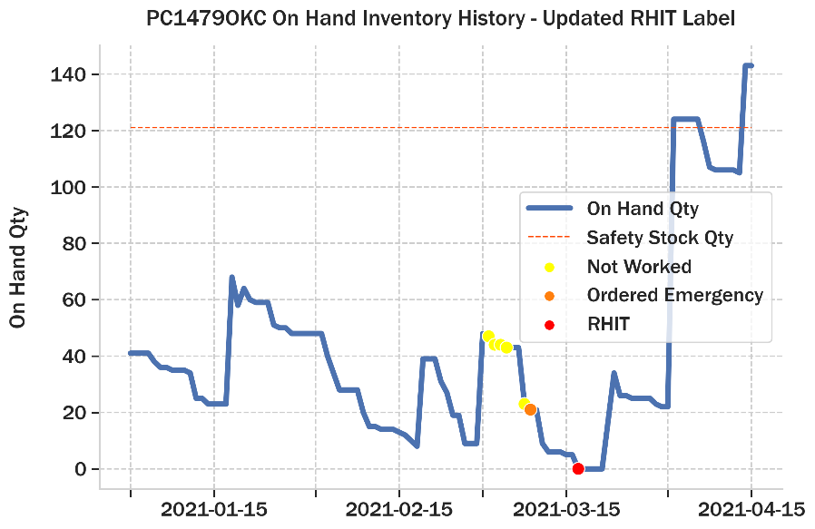
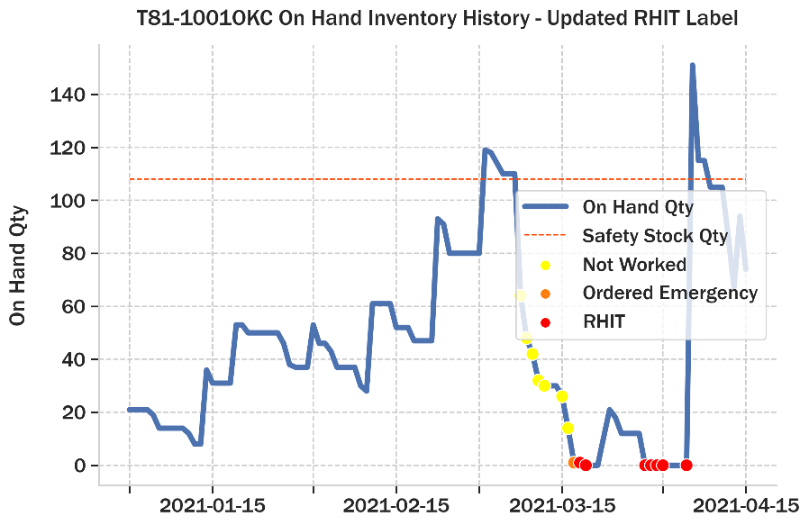
What’s the Impact?

Slide 12
Data Science Problem Statement
To reduce future regional hits, and the time needed to review inventory replenishment suggestions, PACCAR Parts would like a method to identify suggestions that have a “high risk” of taking a future hit. These identified “high risk” suggestions should then be automatically ordered to avoid the risk of taking any future regional hits.

Slide 13
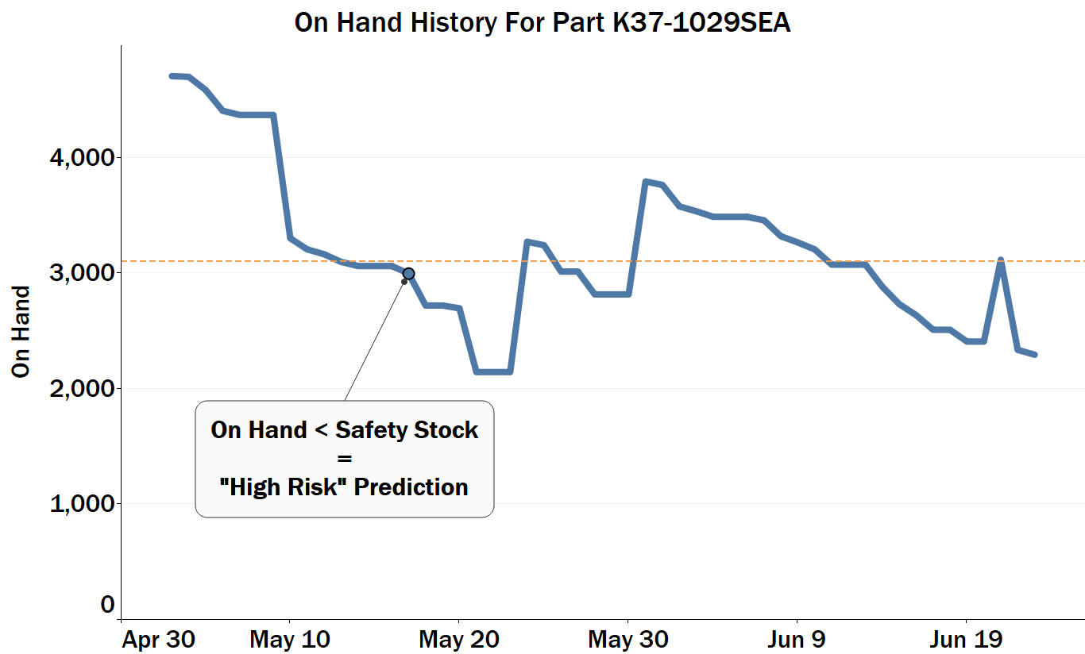
Business Baseline
67%
Accuracy
Accuracy of “High Risk” and “Low Risk” Predictions
51%
Precision
Accuracy of “High Risk” Predictions
* Numbers gathered from test dataset
Safety Stock

Slide 14
Our Final Model
Baseline
Final Model
67%
80%
Accuracy
Accuracy of “High Risk” and “Low Risk” Predictions
Accuracy
Accuracy of “High Risk” and “Low Risk” Predictions
▲13%
51%
75%
Precision
Accuracy of “High Risk” Predictions
Precision
Accuracy of “High Risk” Predictions
▲24%

Slide 15
Project Goals
Improve the Classification Model
Top Question?
Is our model in production today performing the best it possibly can?
Can you?
Improve the model accuracy? (>80%)
Improve the model precision? (>75%)
Send Brett.Durfee@paccar.com Training Accuracy and Precision questions by EOD 5/30

Slide 16
Presentation Deliverables for Next Week
Introduce the problem
Present at least 1 key insight from your data analysis
Introduce your data model
Remember that you’re speaking to the business and not other data scientists
Think about what’s important for them to hear
What variables are the most important?
Present your holdout scores
Why did your model improve? Or why did your model not beat the baseline?
What situations was your model not great at predicting? i.e. Analyze your errors!
Do you recommend keeping the model in production? Or update our model to what you’ve developed?
What are your recommendations on future development to improve this model?
< 10 Minutes

Slide 17
Possible Data Analysis Questions
What patterns are leading to regional hits?
What patterns are leading to regional hits when our days on hand is higher than our safety stock days?
Are certain product lines more at risk than others?
How much of our regional hits are due to lead time issues?
What impacts regional hits more? Poor forecasting or bad lead times?
How does future risk of hits differ between low vs high demand parts?

Slide 18
Data Introduction
Labeling Features
Data Collected Daily – Time series
Item, PDC, Vender
Date | Item | PDC | Vender | Predictors | RHIT_LABEL
01-01-2023 | Tire | SEA | Logans Wheels | … | 1
01-01-2023 | Rim | SEA | Logans Wheels | … | 0
Target Variable
‘rhit_label’
1 = Regional Hit Within Leadtime+5 Days
0 = No Regional Hit In Following Leadtime+5 Days
Notes:
To introduce the data ill start by telling you what you'll see in the index
This data is on the Item PDC Vender level meaning we have the part name, the part distribution center it is shipped from, and the vendor we purchase it from for each part
The data is collected daily making it a timeseries data set
The most important feature in the set is the target variable, rhit_label, standing for regional hit label, this is what we want to predict, and it represents regional fill hits. It is calculated by looking leadtime+5 days ahead of the current date, and seeing if it has a regional fill hit in that time frame.

Slide 19


Types Of Predictors
Supply
On Hand & Days On Hand
On Order & In Transit
Supplier Info
Lead Time & On Time Shipping Info
Demand
Forecasted Demand Variables
Rolling Demand Variables
Velocity
Part Cost
Notes:
There are a lot of features in the data, but they all fit pretty well into two categories, supply and demand.
Supply would be features like ___, and also features that provide information on our suppliers such as ___
Demand would be features that describe the demand for the part. The demand can be described in many ways, simply forecasted demand, or velocity category, or even more just cost

Slide 20

Data Dictionary
Acronyms
DOH: Days On Hand
DOS: Days Of Supply
FCST: Forecast
LTM: Lead Time
MDI: Managed Dealer Inventory (A Team At PACCAR)
OH: On Hand
OO: On Order
ORD: Order
OTS: On Time Shipping
PCT: Percent
PDC: Part Distribution Center
SPQ: Standard Packing Quantity
SS: Safety Stock
SUG: Suggestion – Refers To Suggested Order
Particularly Confusing Features
DOH_LESS_SS: Bool, True when we have DOH Below SS
NETWORK_AVAIL: How Many Locations In The Network Have Inventory
OH_OO_SUG_DOS: (On Hand+On Order+Suggested Order Quantity) / Daily Demand Forecast
Notes:
At PACCAR we love our acronyms, there are a lot of them in the column headers, using this dictionary you should be able to decode all of the features

Slide 21

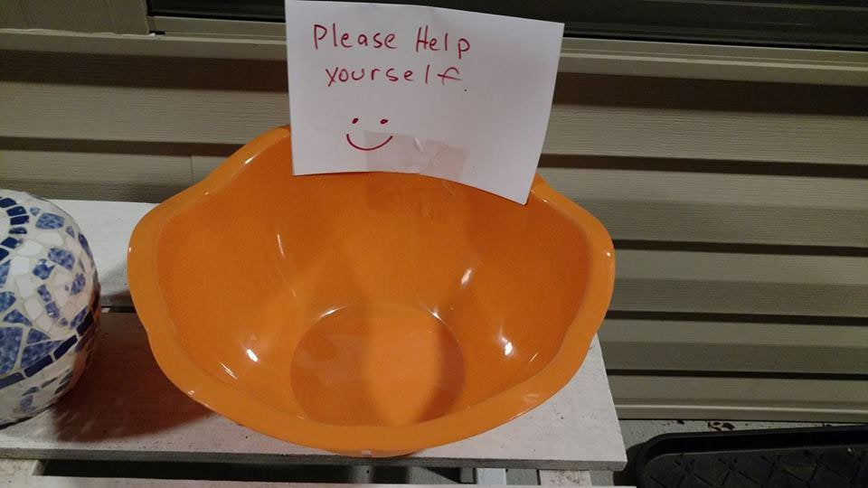
Considerations
Handling Missing Values
Fill Contextually Using Other Features?
Interpolation Techniques?
Drop?
Feature Selection
Which Features Are Most Important?
Multicollinearity?
Notes:
There are nan in this data set, this is something you'll have to figure out how to handle, there are many strategies to do so
Think about what causes nan and go from there
There are also 80 features total, you must decide which ones you want to use in your model. There are many things to consider while making that decision
Its like one of those candy bowls on Halloween, you could take them all, but should you?

Slide 22
Any Questions?
Contact Me
brett.durfee@paccar.com

Slide 23

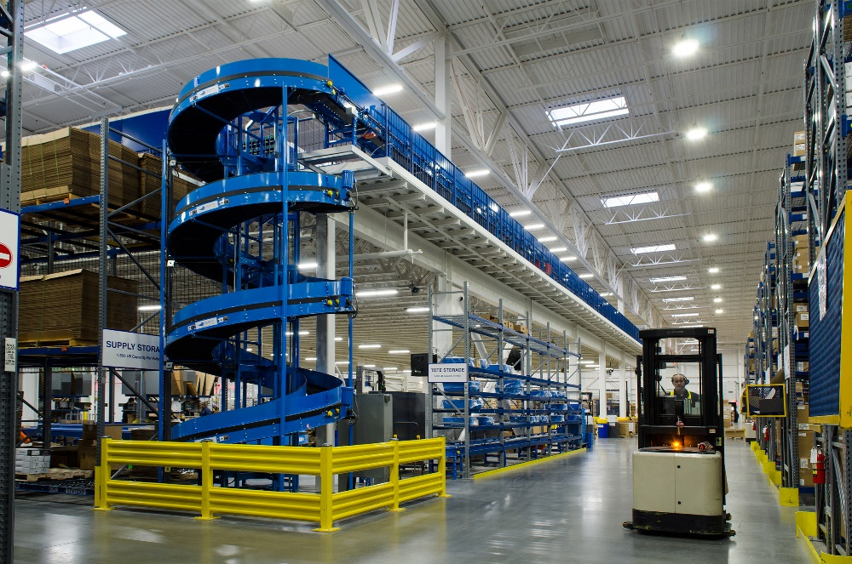




Slide 24

GitHub Demo

Slide 25
Github Access
Please Add the following usernames to access your repo: Rylee-Iacolucci_paccar Logan-McKerlich_paccar

